Slide 1


Pennsylvania Ave West Streetscape
Summary of June 27, 2019 Public Meeting

Slide 2
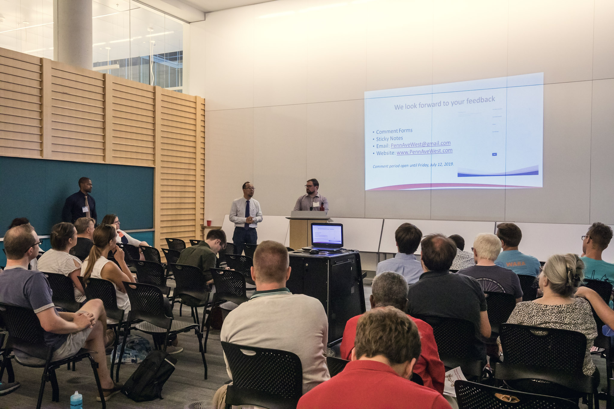
1.0 INTRODUCTION
On Thursday, June 27, 2019, the District Department of Transportation (DDOT) held the first public meeting of the Pennsylvania Avenue West Streetscape Project (Penn Ave West). The purpose of the meeting was to provide an overview and history of the project, present current progress and gather feedback.
Project Background
Penn Ave West introduces protected bike lanes and improves the public experience along Pennsylvania Avenue in northwest DC between 17th Street and 22nd Street. The Project will also enhance the monumental corridor, provide a safe connection to destinations and neighborhoods for all transportation modes, and introduce green infrastructure to support the city’s sustainability goals.
This project builds on the Golden Triangle Business Improvement District’s (BID) 2015 West of the White House Study and DDOT’s 2017 Downtown West Transportation Planning Study. These projects have helped develop a vision for the future of the corridor while also outlining key policy priorities and strategies to meet the project’s goals and objectives.
As part of the Downtown West Study, DDOT formed a Citizens Advisory Group (CAG) consisting of representatives from the Advisory Neighborhood Commissions, Pedestrian Advisory Council, Bicycle Advisory Council, BIDs, and other key stakeholders. DDOT shared data and analyses with these leaders in the community throughout the project, allowing them to receive critical feedback and bring transparency to the process.
This document summarizes the first public meeting for the Penn Ave West Streetscape Project.
1.1 Event Information
The public meeting was held on Thursday, June 27, 2019 at the West End Public Library located at 2301 L Street NW, Washington, DC 20009 from 6pm – 8pm.
A 30-minute presentation included information on the two previous studies and introduced the Penn Ave West Project and its progress so far.
The project team provided a detailed plan of the project area as well as block-by-block renderings for attendees to review and provide comments.
Following the presentation, public comments were encouraged and received until July 12, 2019, two weeks after the public meeting.

Slide 3
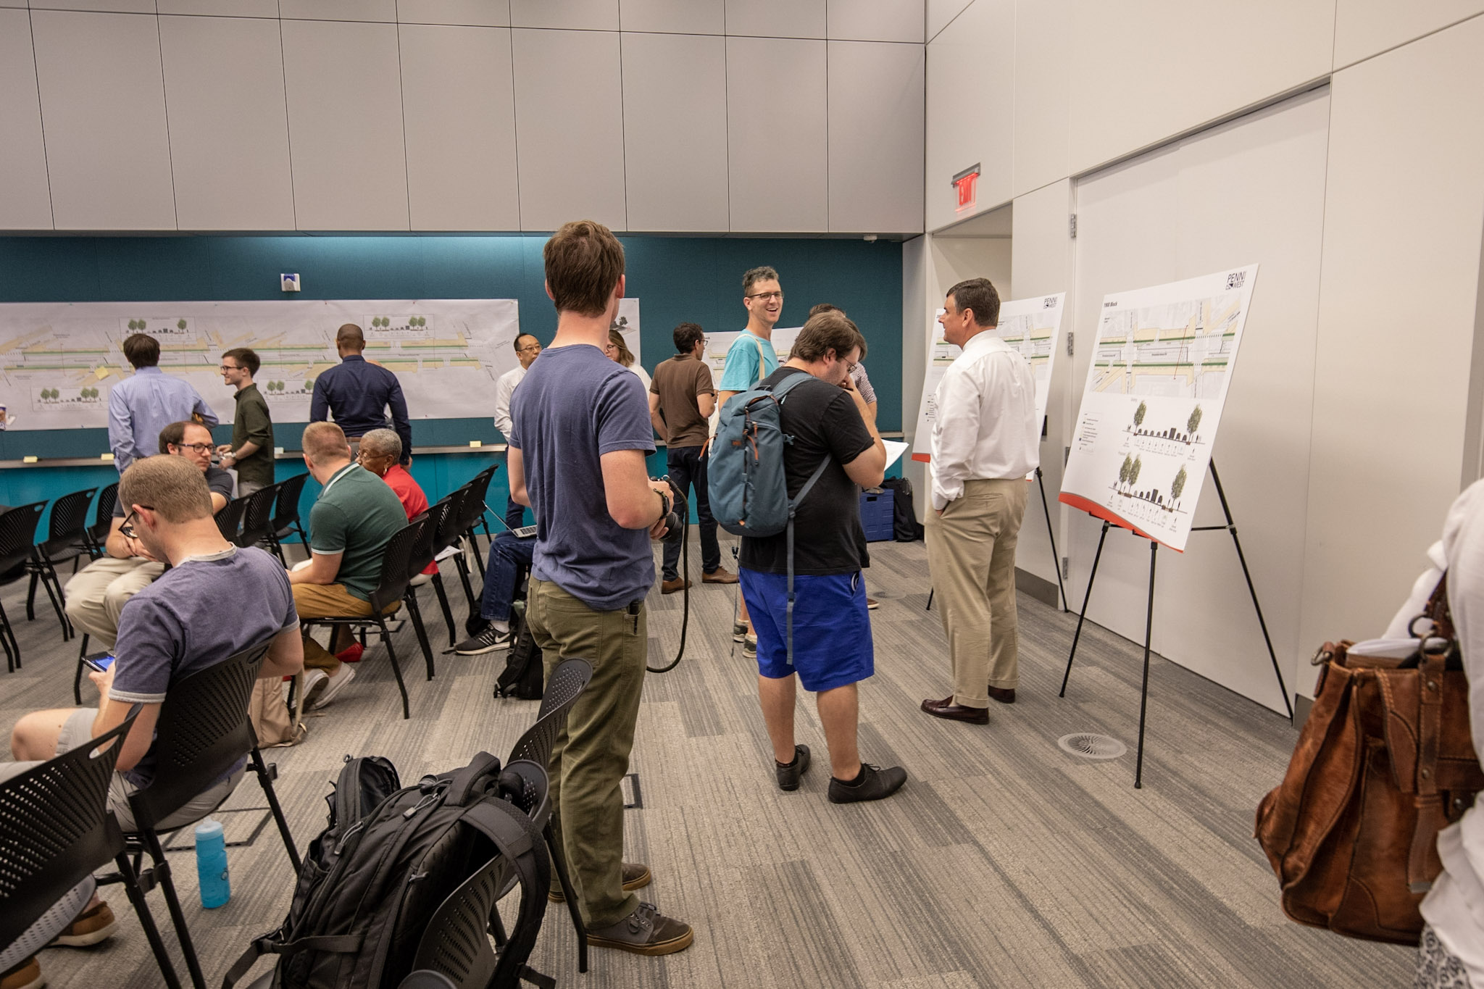
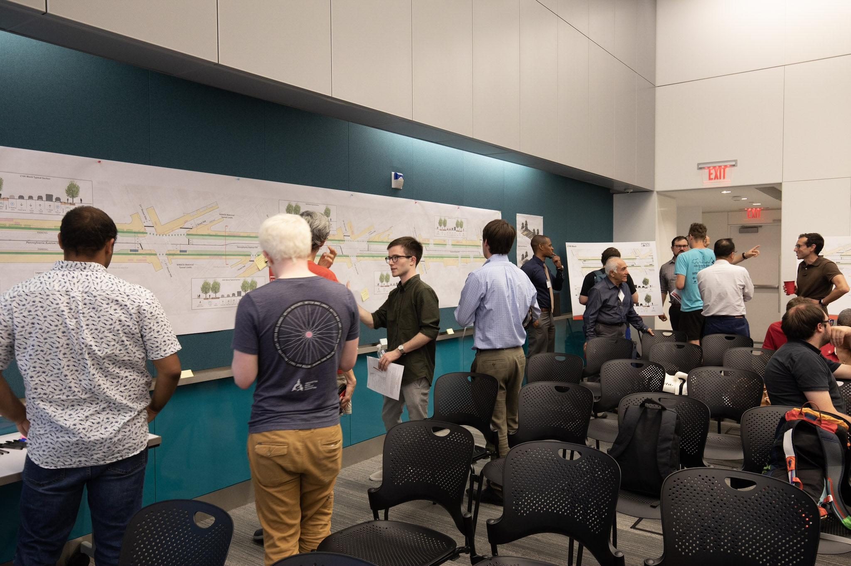
1.2 Boards and Informational Materials
The project team provided a detailed roll plan of the project area, as well as block-by-block renderings for attendees to review, ask questions, and provide comments on sticky notes and comment cards after the presentation and 20-minute Q&A session.
Boards
Five (5) proposed block-by-block boards with existing and proposed cross sections and detailed plans for the following blocks:
  2100 Block
  2000 Block
  1900 Block
  1800 Block
  1700 Block
An Existing and Proposed Typical Section cross-section was also pinned on a wall beside the roll plan.
Roll Plan
A 28-inch by 200-inch map of the study area was displayed on a wall in the meeting room. The map showed the existing roadway with highlighted changes to the roadway geometry and the approximate locations of proposed median landscape areas, floating bus islands, bike lanes, and crosswalks. The roll plan also included cross-sections of each block with widths of medians, travel lanes, and bike lanes.
Handouts
Each attendee received a Title VI questionnaire with comment sheet and a project flyer (see Section 2.2).

Slide 4
2.0 OUTREACH EFFORTS
The following section summarizes the outreach efforts for this project.
2.1 Public Meeting Notice
A formal public meeting notice was distributed by the DDOT Communications office to their media distribution list, residential list, and on DDOT’s Twitter and Facebook postings. A full copy of the notice is posted to DDOT’s website here: https://ddot.dc.gov/release/penn-ave-west-streetscape-project-public-meeting
2.2 Project Flyer
A project flyer provided a synopsis of the project to date including the former studies with an anticipated timeline toward construction as well as the project area.
2.3 Stakeholders
The project team and the Golden Triangle BID hosted a preliminary meeting with property owners along the corridor on Monday, June 24, 2019. DDOT presented the public meeting materials and allowed the property owners to ask questions and provide feedback on the project.
The project flyer was distributed throughout the study area and to meeting attendees.

Slide 5
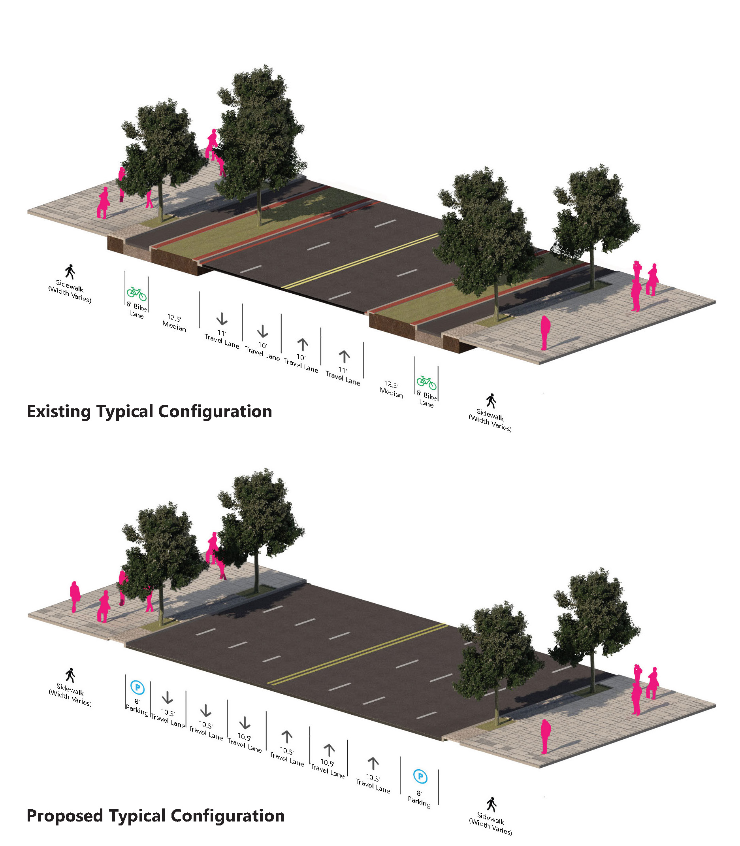
2.3 Stakeholders (continued)
The project team contacted ANC commissioners, institutions, interested stakeholders, and the Washington Area Bicyclists Association (WABA) via phone calls and e-mails.
Public meeting notices and project flyers were hand delivered to each business and property located along the corridor in advance of the public meeting.
The following stakeholders were notified prior to the public meeting:
    Advisory Neighborhood Commissioners 2A, and 2B interested stakeholders
    George Washington University
    US Department of State
    National Academy of Sciences
    Federal Reserve Bank
    World Bank/International Finance Corporation
    International Monetary Fund
    Golden Triangle Business Improvement District
    Cyclists’ Groups
      Washington Area Bicyclist Association (WABA)
      DC Bicycle Advisory Council

Slide 6
3.0 ATTENDANCE
There were a total of thirty (30) members of the public at the June 27th public meeting, including residents, ANC commissioners, stakeholders, a Golden Triangle BID representative, business owners, George Washington University students and local bicycle advocates.
The charts below represent the demographic makeup of the meeting attendees based on the twelve (12) Title VI forms completed.
6

Slide 7
4.0 SUMMARY OF COMMENTS
Attendees provided written comments on Post-It notes pinned to the roll plan and boards. DDOT encouraged submission of additional comments via email, mail, the project website, and comment cards distributed prior to the presentation. All comments were due by July 12, 2019, two weeks after the meeting.
The following is a summary and key takeaways of the comments and questions received during the twenty-minute Q&A session following the presentation.
4.1 Key Takeaways from 20-Minute Q&A Session after Presentation
Q. Connecting to Georgetown at L Street is a big concern and connection through Washington Circle should be address as part of this project.
A. The circle is not included in this plan but will be looked at for future efforts. The team is coordinating with the ongoing 20th/21st/22nd street bike lane project.
Q. H Street turn needs to have a focus on ped/bike safety.
A. This is part of the 30% design plan and will be addressed upon its completion.
Q. Concern with deliveries and inoted loading information was “nowhere on the plan.” Need to discuss next level in deliveries with increased numbers of delivery trucks including FedEx, Amazon as well as car share such as Uber and Lyft.
A. This is part of the 30% design plan and will be addressed upon its completion.
Q. Is there an opportunity to widen bike lanes further and decrease the median?
A. The team is considering all options with a final recommendation at the 30% design completion.
Q. What is the business communities’ input with regard to decreasing parking?
A. (Addressed by David Suls from Golden Triangle BID) The business community has also been briefed and has had opportunities for input and feedback.
Other comments included:
The public would be interested in hearing more about drainage issues and decisions.
Is the use of the Metro a driving factor in this project?
Can trees be a barrier to the bike lanes?
What is Pepco and DC Water doing? When FIOS was installed in my neighborhood, many streets that were recently paved were destroyed. Who is going to pay for the impact on utilities that need to be relocated because of this?
Will this project cause utility rates to increase?
4.2 Comments on Roll Plan and Boards
The following is a list of the comments and questions received on sticky notes and comment cards.

Slide 8
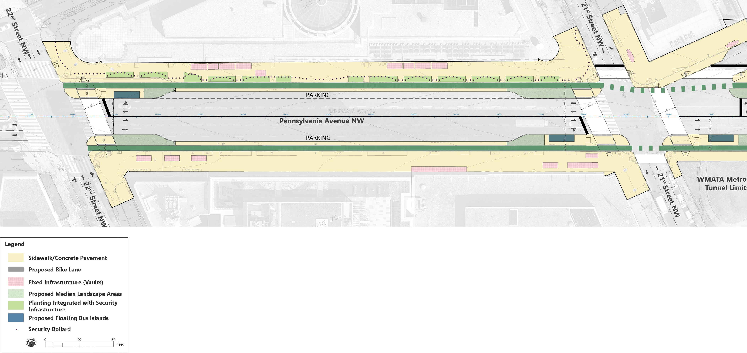
2100 Block Public Comments
*
3
1
2
General Comments:
Please include bus lanes for the many buses that use this street (30N, 30S, 32, 33, 36, 38B, circulator)
Location Specific Comments:
I know this is beyond the scope of the project, but Washington Circle is a disaster for all users: pedestrians, bikes, cars, buses, etc.
Extend 21st Street cycle track to here and NH.
There should be protected corner islands to keep the drivers out of the bike lane mid-intersection.
Indicates a requested bike box for left turning cyclists.
*

Slide 9
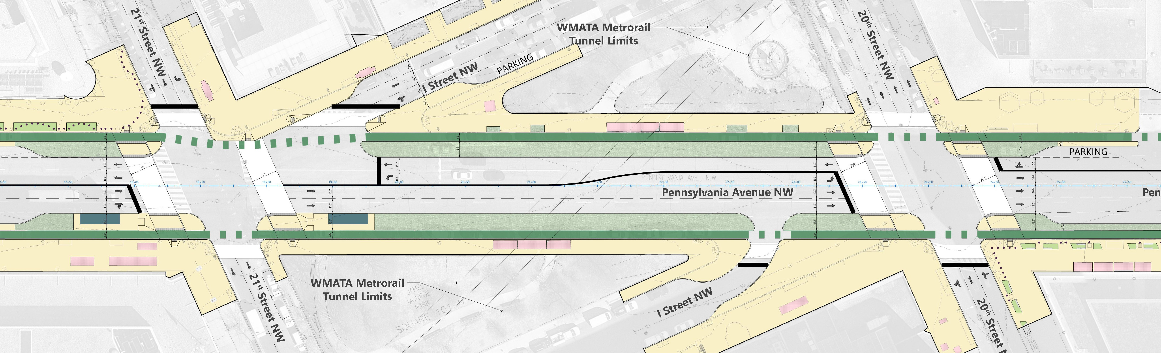
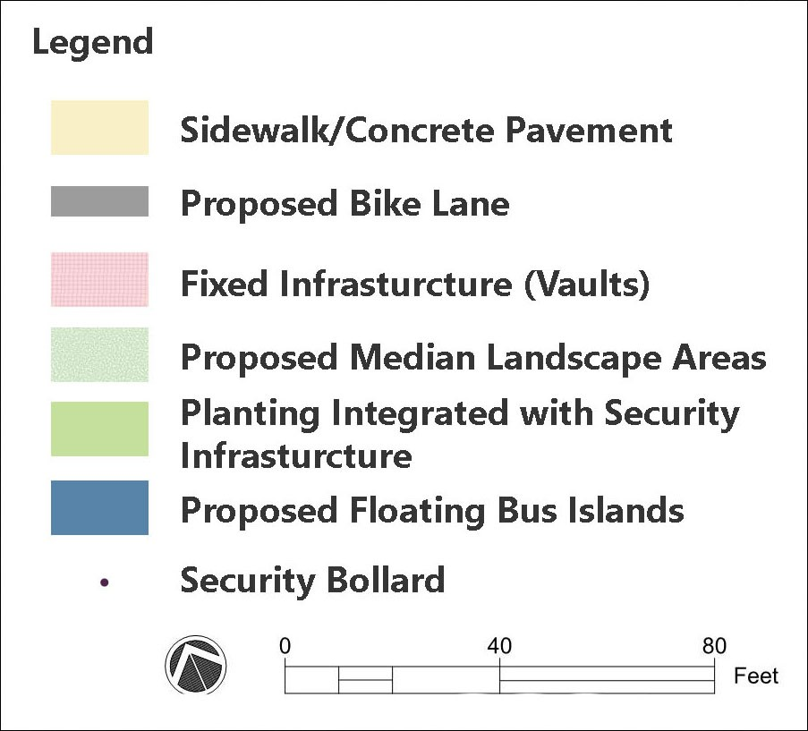
2000 Block Comments
*
2
1
General Comments:
Can we cul-de-sac I Street NW?
For bikes turning eastbound onto Penn Ave, include a place next to the crosswalk on the west side of the intersection where southbound cyclists can pull in and queue just west of 20th Street NW. See
The two way cycle track on the south side of the drawing is just a concept for getting northbound cyclists west to reach I Street westbound. I think the ANC was discussing this.
Location Specific Comments:
Include a crosswalk here (in addition to the other crosswalks shown).
We need to see an I Street two-way PBL connection here. Ask Commissioner Harnet.
Indicates a requested bike box for left turning cyclists.
*
*

Slide 10
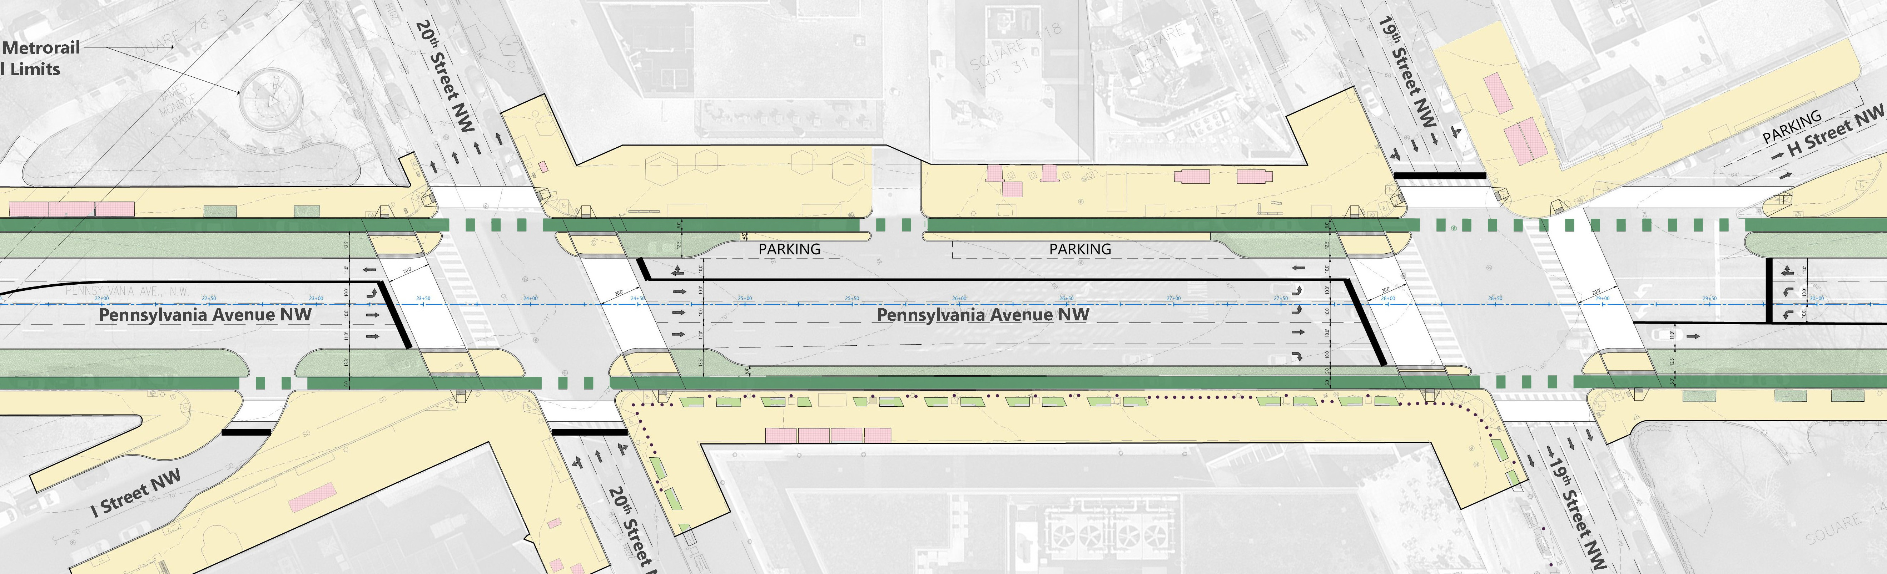
1900 Block Comments
*
1
2
General Comments:
Protected intersection and connection to 20th Street cycle track is also being designed by DDOT.
The intersection of 19th St NW and H St NW is getting a signal in 2019.
Location Specific Comments:
This intersection could use a curb extension here. (+3)
Consider wider bike lanes with the security bollards.
Indicates a requested bike box for left turning cyclists.
*

Slide 11
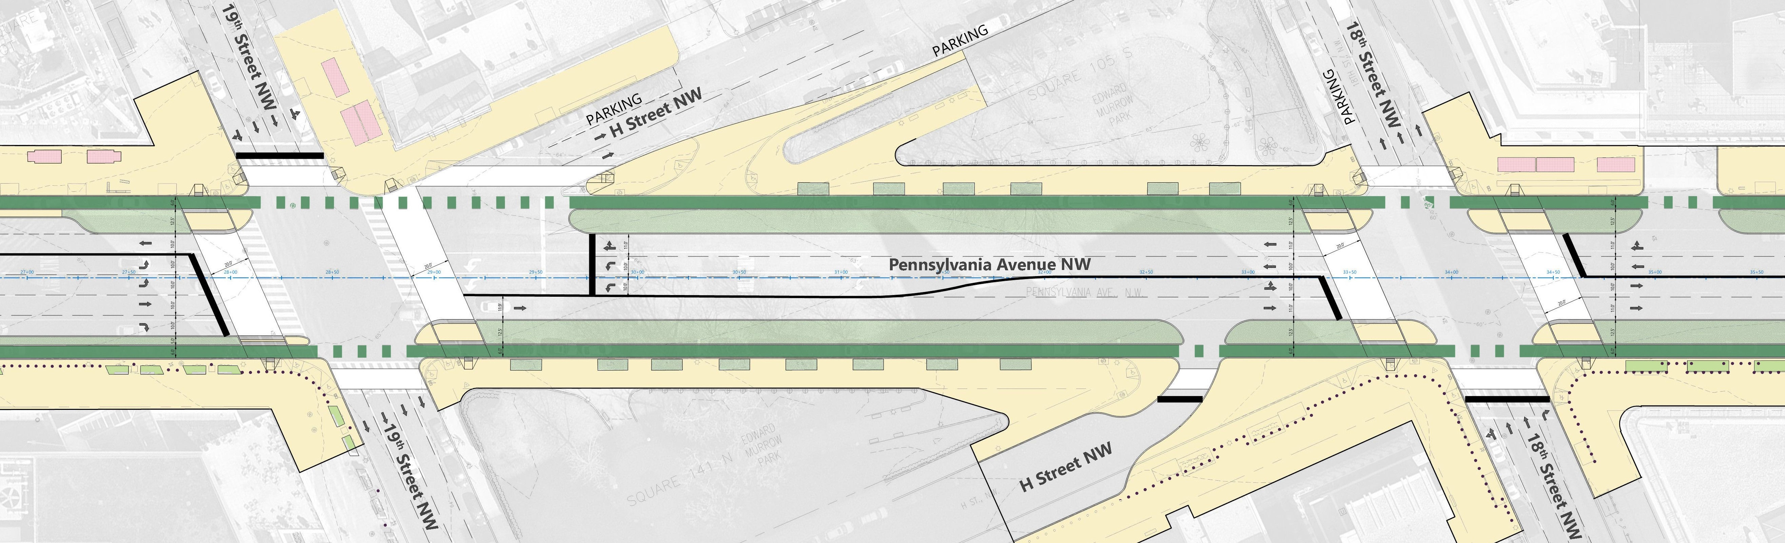
1800 Block Comments
5
1
3
2
*
4
General Comments:
Keep capability for a westbound contraflow bus lane on H Street NW (which it looks like you’re indeed doing - thanks!).
Include leading pedestrian intervals (LPIs) at all intersections.
How do I safely get onto 18th Street NB from the Penn Ave EB bike lane?
Location Specific Comments:
This intersection could use a curb extension here. (+3)
Include crosswalk here (in addition to other crosswalks shown).
Ban this right turn.
Can we cul-de-sac H Street here?
Bulb-out for 18th Street NW parking lane? Put this in other locations too?
Indicates a requested bike box for left turning cyclists.
*

Slide 12
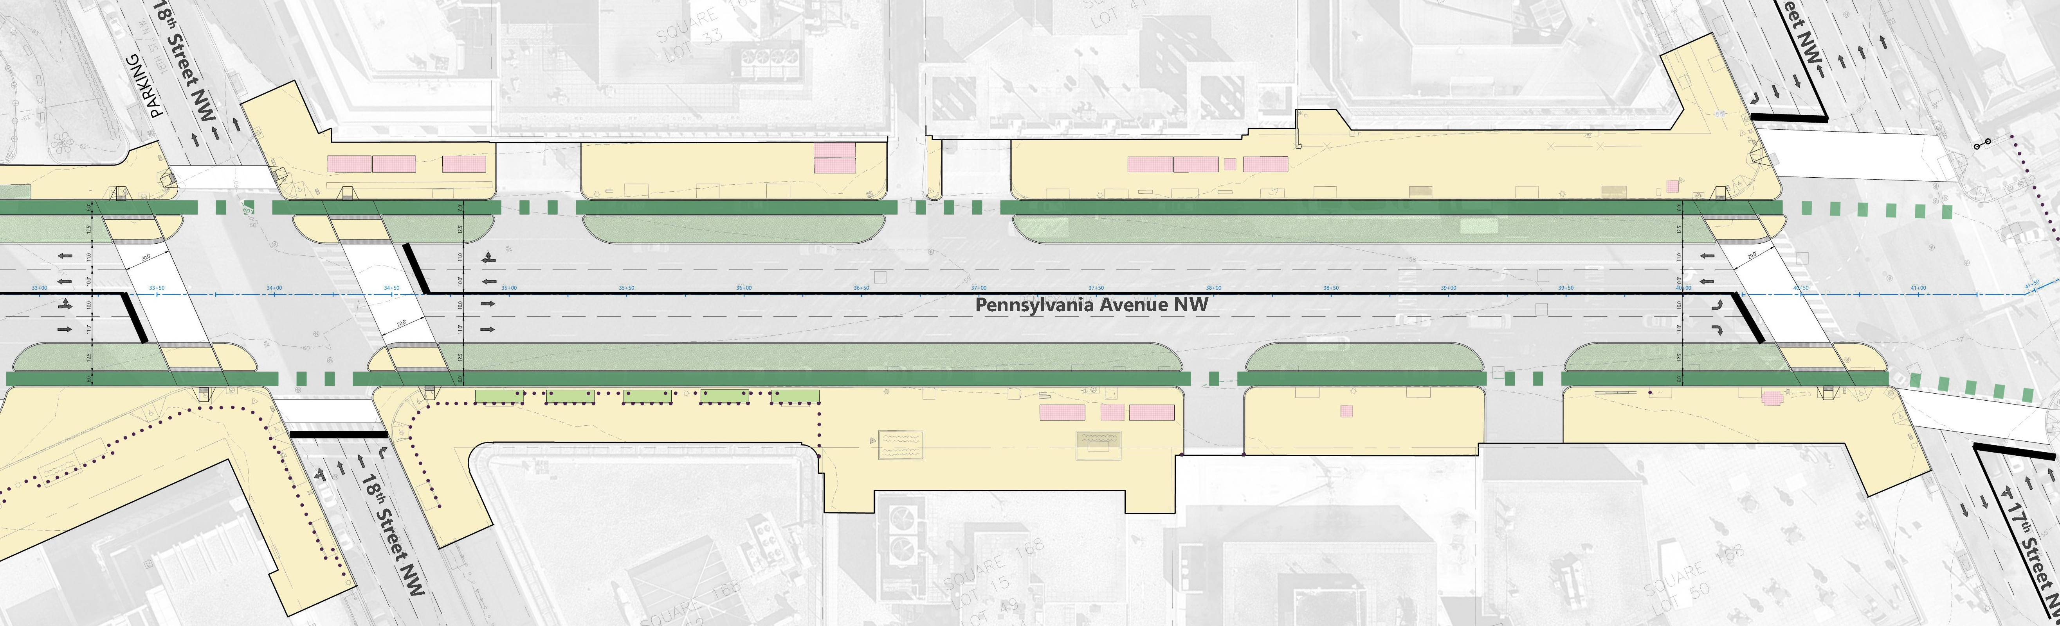
1700 Block Comments
1
*
4
*
2
3
General Comments:
1500 and 1600 blocks of Penn Ave are frequently closed to bikes and pedestrians. We need an alternate route.
Location Specific Comments:
Any plans for 17th Street PBL?
More protection for pedestrians needed here. Cars don’t stop for pedestrians.
Consider desire lines – pedestrians will be drawn to going straight to the square.
Need to consider Lafayette Square shutdowns. This impacts 15th Street commutes often. (+2)
Indicates a requested bike box for left turning cyclists.
*

Slide 13
4.3 Summary of All Public Comments
  The following is a summary of the comments and questions received during the public meeting and through the project email and website.
  Bike lanes
    Bike lanes need to be 7-feet wide (some request 8-9 ft) to allow cyclists to pass slower riders, allow side-by-side riding, queuing at intersections, and to allow DPT street sweeping and plows.
      NACTO standard width is 7’ for one-way protected bike lanes.
    Curbs in the bike lane should have less than a 90° angle (ideally 45°) to avoid pedal strikes and reduce shy distance. Similar curbs are on First St NE in NoMa.
    Extend the project area past Washington Circle to Georgetown and the M and L cycle lanes.
    Two-stage turn boxes and safe areas to queue for turns should be added.
    Build a two-way protected bike lane connection along southern I St between 21st and 20th Streets. GW students support 21st cycle track, but Penn Ave West needs to coordinate with 21st cycle track.
    Consider protected intersections, especially at 20th/21st Street cycle track project.
    There should be a dedicated phase at 19th for bikes to avoid right hooks. NACTO’s “Dedicated Intersection” is a good guide.
    Make sure bicycles are not forced to wait a long time for dedicated bike phases. There should be a balance of bicycle safety from turning vehicles and bicycle wait times.
    Add more trees to the median at 1900 block and locations with curb extensions to shade the bike lanes during the summer.
  Traffic and Parking
    Remove more parking.
    Do any of the traffic studies include or factor in bicycle usage under adverse weather conditions?
    Has any study contemplated the required off-set requirement for the biking that is eliminated?
    What traffic studies have been conducted to determine ADT in each lane? What is the impact when lanes are converted to bike lanes and greenspace?
    Has DDOT studied comparable east-west corridors to determine bicycle ADT on Penn Ave West?
    Has there been a comparison of the volume of the two usages by vehicular type?
    Consider rideshare and taxi pick-up/drop-off. Determine where deliveries for businesses will take place – in alleys or on Penn Ave.
  Other Comments
    Requested in more than half of comments: Implement a temporary version of this plan, similar to Florida Avenue. Use temporary materials to add protected bike lanes, widen sidewalks, and calm traffic.
    Include bus lanes on Penn Ave connecting to Washington Circle for 30N, 30S, 32, 33, 36, 38B and Circulator buses. These should be prioritized over cars.

Slide 14
4.5 Summary of ANC 2A Resolution
The following is a summary of the unofficial final copy of the ANC 2A Resolution sent to DDOT on Monday, July 22, 2019.
ANC 2A supports:
  The project objectives and goals;
  Increasing the width of the permanent separated bike lanes by one (1) to seven (7) feet to allow for greater passing width and enabling the use of DPW clearing equipment to clear away snow and debris;
  Leveling the proposed bike lane with the median, making it safer for passing bicycles and protect against stormwater runoff issues; and
  Removing all on-street metered parking and dedicating it to commercial and rideshare loading spaces, especially on the southwest segment of the 1900 block.
The Commission cannot wait until 2022 for safer conditions on Penn Ave West and supports DDOT immediately implementing temporary measures through an NOI that would create and implement the following until the permanent project is ready for construction:
  Road Diet,
  Protected bike lanes, and
  Improved pedestrian elements.
ANC 2A requests and expects that DDOT be timely, transparent, and accountable to the community concerning issues that could cause delay or alteration of the project.

Slide 15
5.0 MOVING FORWARD
The next public meeting will be held in fall of 2019 after the completion of the 30% design. The goals moving forward are:
  Design the streetscape
    Streetlights, bike racks, and benches
    Planting and hardscape design material selection
    Green infrastructure and low impact development
    Traffic signal design
  Coordinate with cycle track on 20th St NW with east-west connection to 21st St NW.
  Use public input to finalize 30% design.

